Slide 1
Public School 174
65-10 Dieterle Crescent
Rego Park, New York 11374
Karin Kelly, Principal
Kerstin Kobetitisch, AP
Laura Hui, Parent Coordinator
LHui2@schools.nyc.gov
Year Born 2016 New Kindergarten
Open House
Via Google MEET
Wednesday, January 13, 2021
10am-11am
2pm-3pm

Slide 2
MySchools.nyc
Apply online by January 19
Over the phone by calling 718.935.5100
Available in languages.
Offer in the Spring
Kindergarten maximum class size 25
Grades 1 to grade 5 maximum class size 32
Additional details at --Schools.nyc.gov/Kindergarten

Slide 3
Admissions Priorities for Zoned Schools
All zoned elementary schools make offers to students in the following order:
Students who live in the zone and have a sibling at the school
Other students who live in the zone
If space allows, students living outside the zone may also be admitted, in the following order:
Students with a sibling at the school who live in the district
Students with a sibling at the school who live outside the district
Students who live in the district and are currently enrolled at the school for preK
Students who live outside the district and are currently enrolled at the school for preK
Other students who live in the district
Other students who live outside the district
Visit
NYC website-
Video,updates
Schools.nyc.gov/Kindergarten

Slide 4
School Hours
Monday- Friday
8:30am -2pm
subject to change
School Day
8 periods - 50 minutes
Reading
Writing
Math
Lunch
Centers
Clusters/Subject teachers once a week
Art
STEM
Movement Ed
Music/Performing Arts

Slide 5
Meals.
Breakfast, Lunch Free for all students.
Option to bring your own lunch.
Menu online
Recess/Outdoor
As weather permits in Little School Yard (Ellwell Crescent)
Transportation.
The Office of Pupil Transportation determines eligibility not the school. Please request at registration.

Slide 6
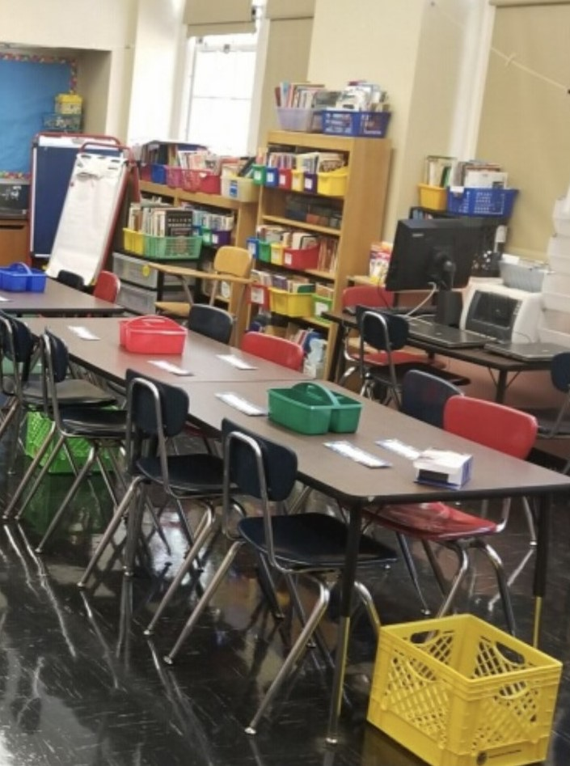
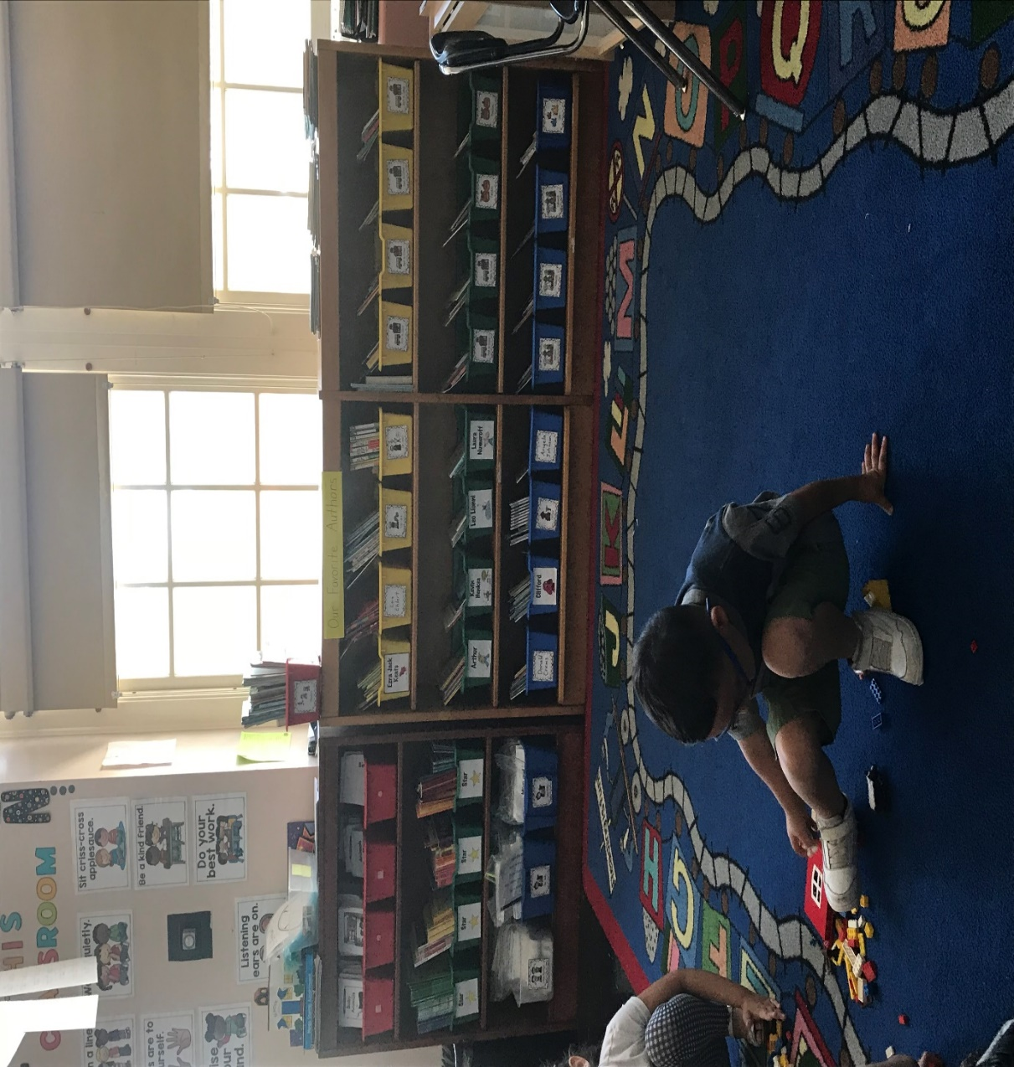

Slide 7
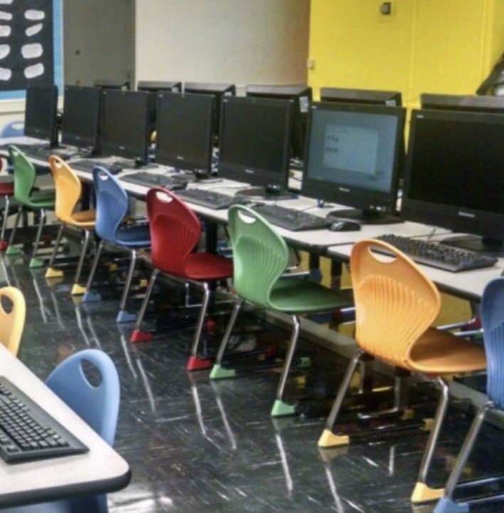

Slide 8
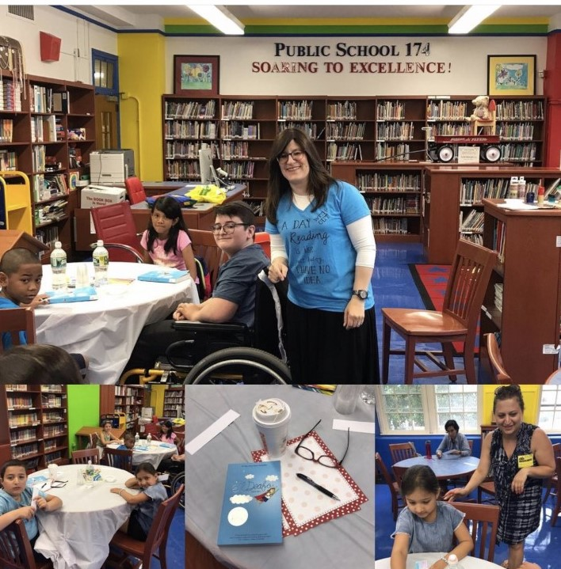

Slide 9
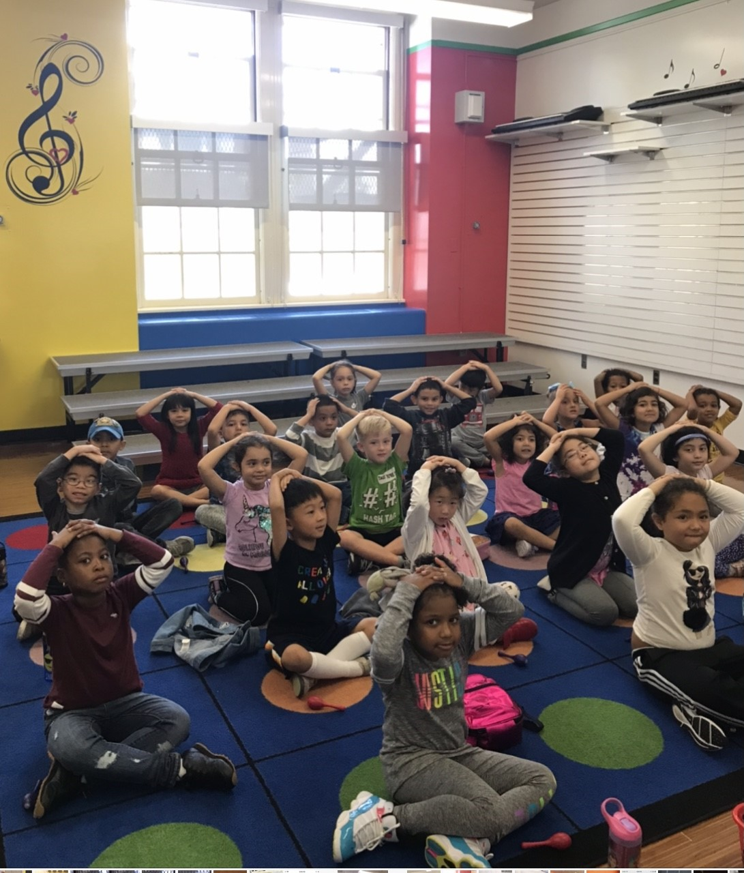
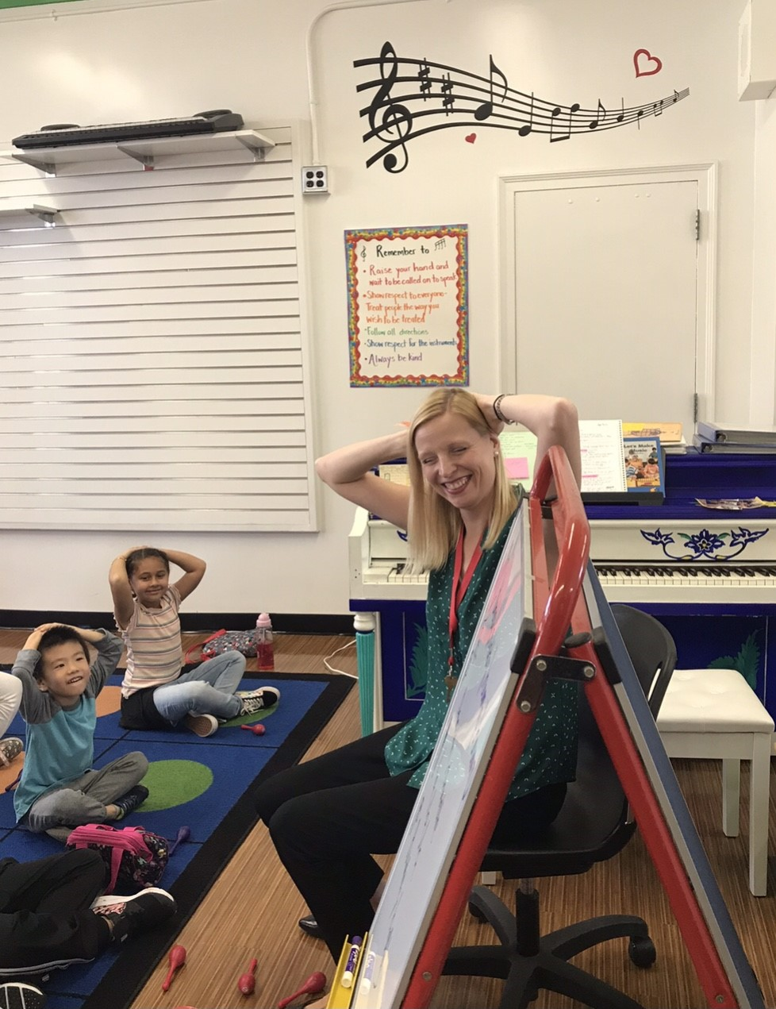

Slide 10
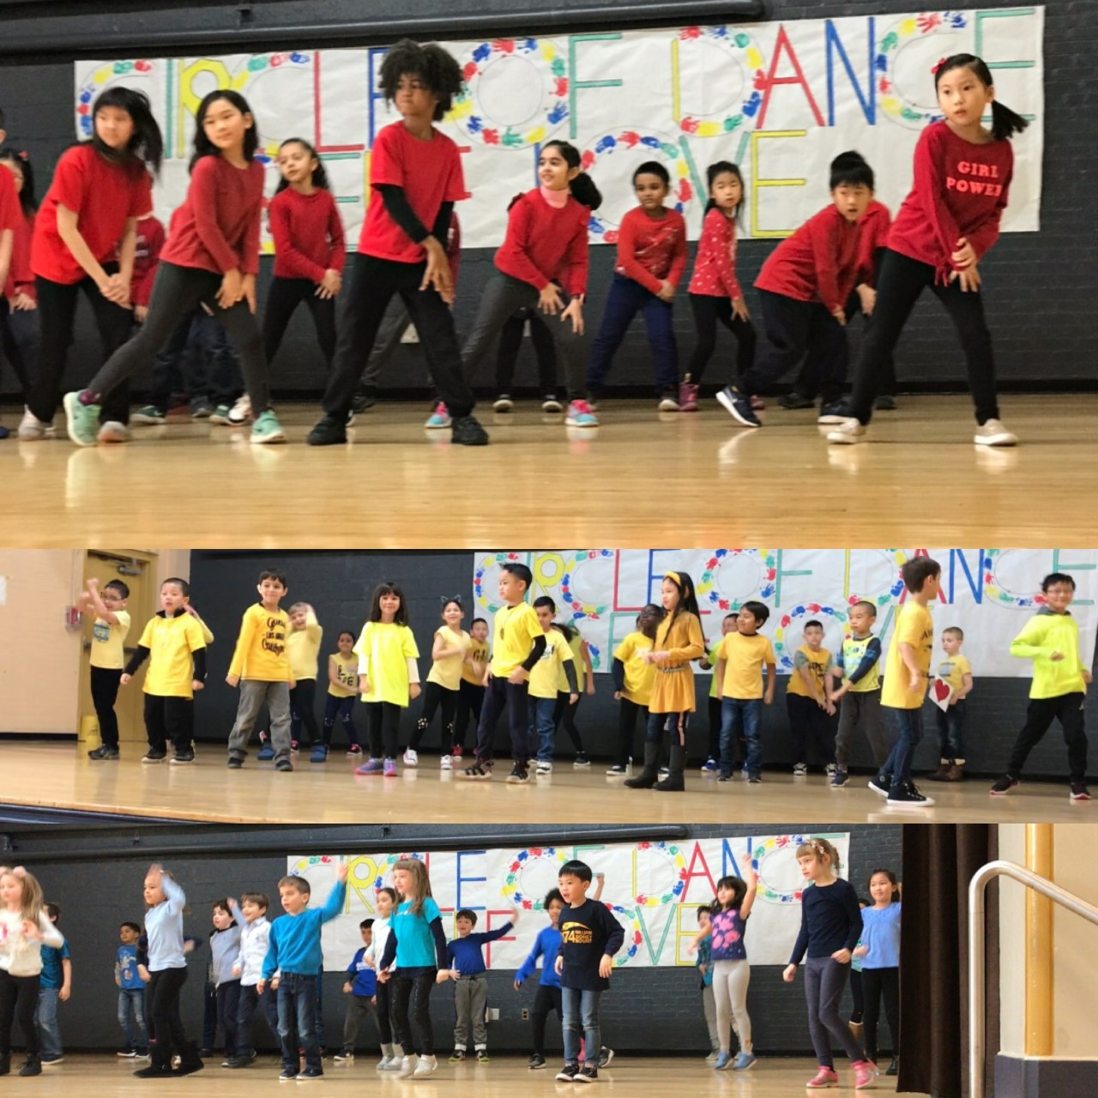

Slide 11
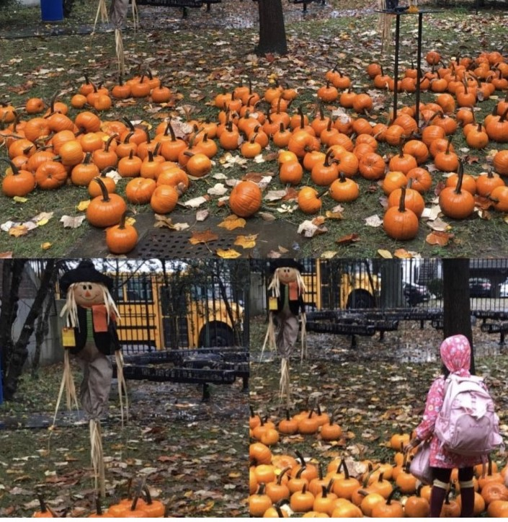

Slide 12
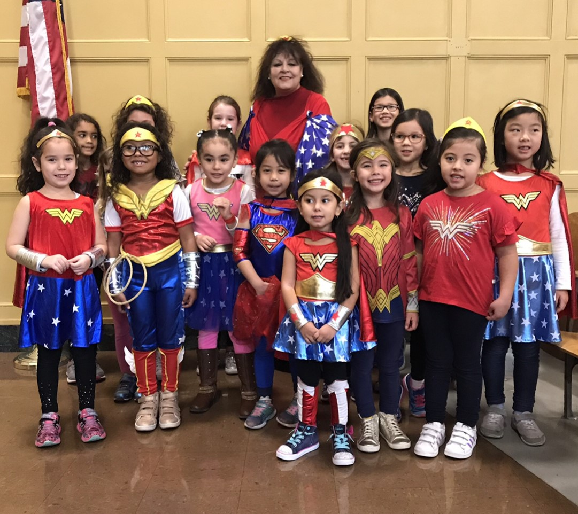

Slide 13
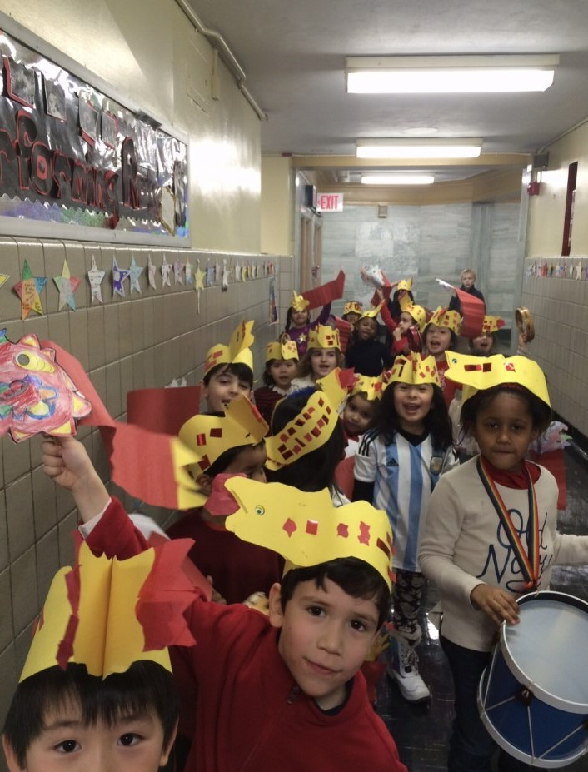
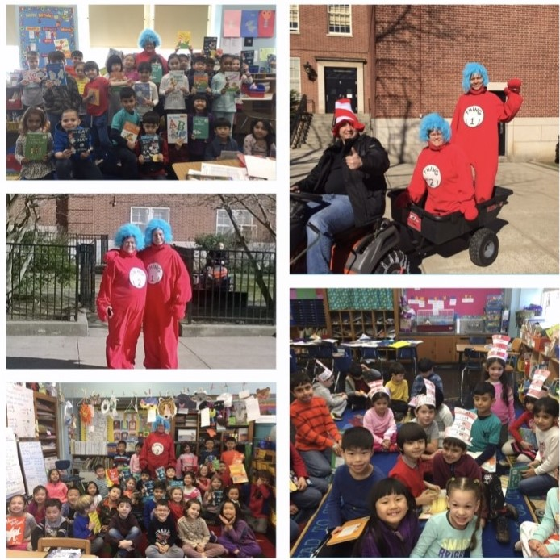

Slide 14
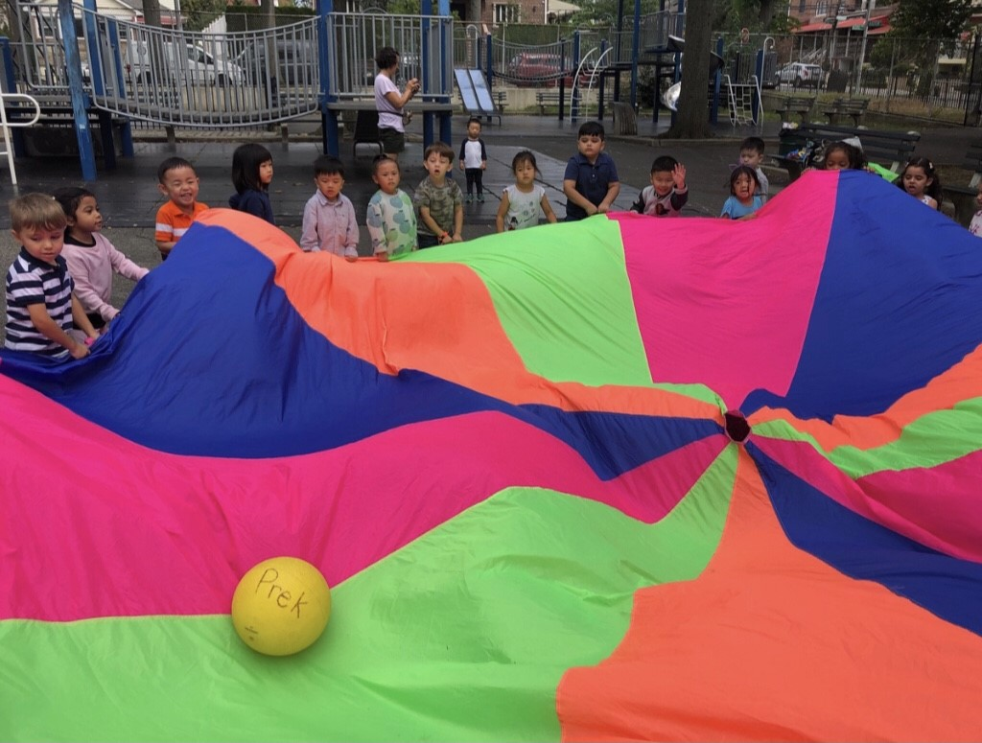

Slide 15
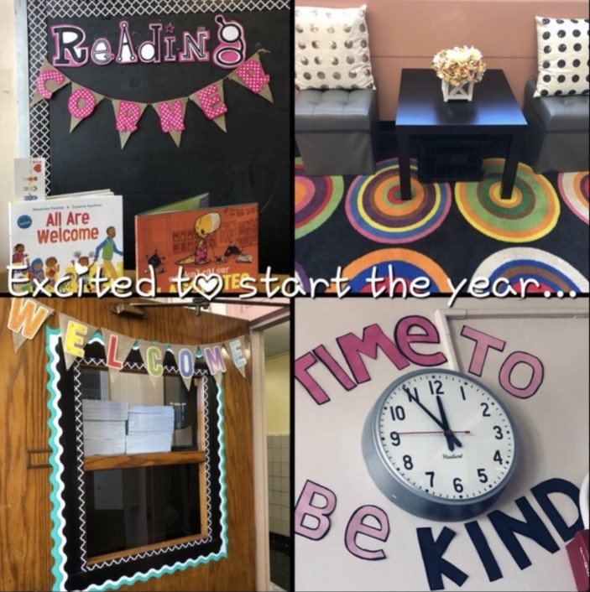

Slide 16
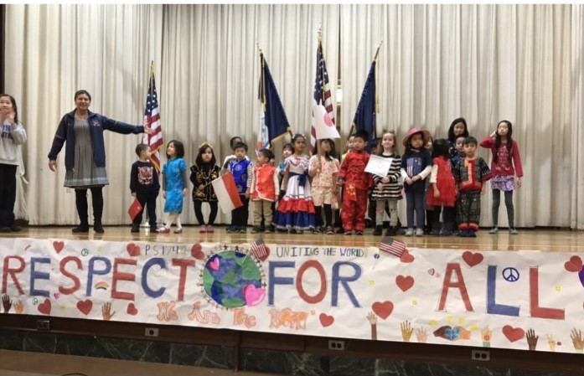

Slide 17
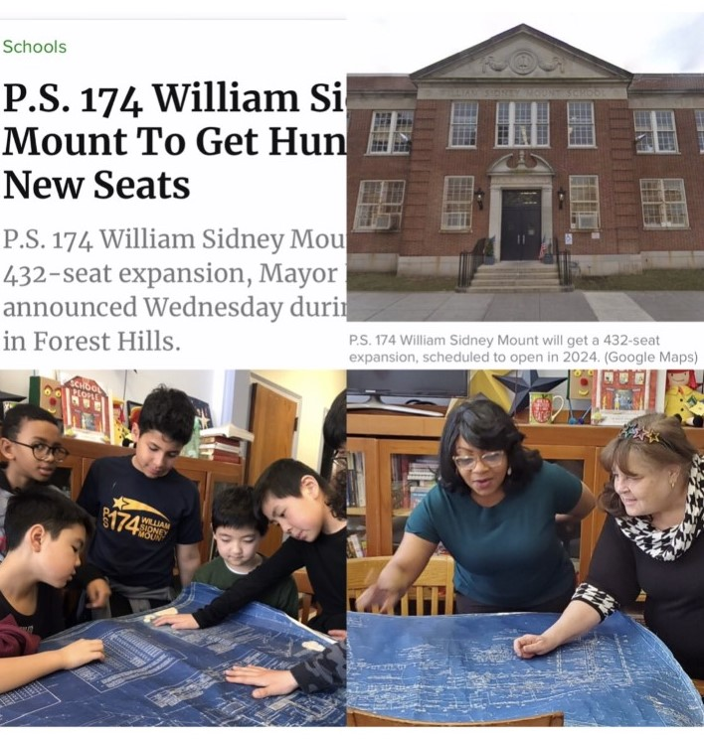

Slide 18
Today----
Full Remote- Learning At Home via Google Classroom
Blended Learning- 2/3 Days in person and
2/3 days remote learning at home
via Google Classroom

Slide 19
Resources—check back for updates--
NYC website: Schools.nyc.gov
School website: ps174.org
Any questions--
Email Laura Hui, Parent Coordinator PS 174
LHui2@schools.nyc.gov

